Slide 1
Output Input
/^\/^\
_|__| o |
\/ /~ \_/ \
\____|__________/ \
\_______ \
`\ \ \
| | \
/ / \
/ / \\
/ / \ \
/ / \ \
/ / _----_ \ \
/ / _-~ ~-_ | |
( ( _-~ _--_ ~-_ _/ |
\ ~-____-~ _-~ ~-_ ~-_-~ /
~-_ _-~ ~-_ _-~
~--______-~ ~-___-~
Hyland Python Academy @ UCS
Libraries

Slide 2
Your First Python Program
print("What up world")
Quotation marks ""
Within
Text to print
Within
Parentheses ()
Followed by
The word print

Slide 3
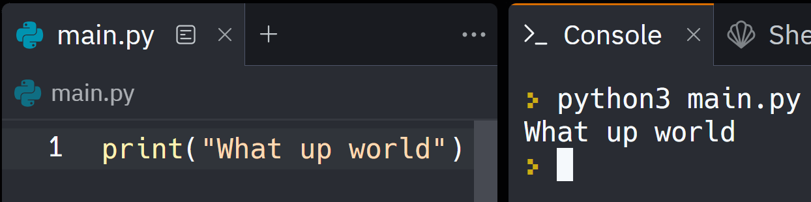
Your First Python Program
print("What up world")

Slide 4
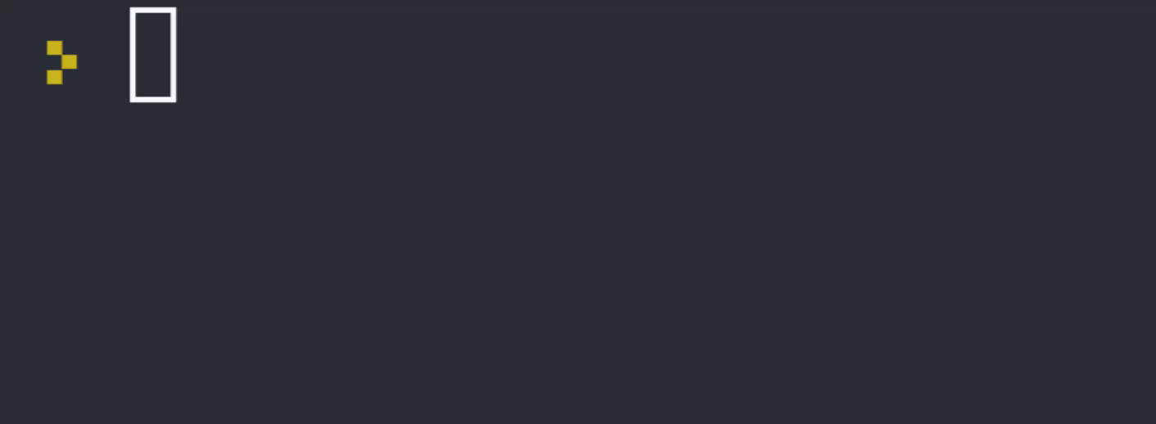
Your Second Python Program
name = input("What's your name?")
print("What up " + name)

Slide 5
Your Second Python Program
name is a variable that holds the text
+ adds text values together
= sets the value of the name variable
input lets the user enter text
name = input("What's your name?")
print("What up " + name)

Slide 6
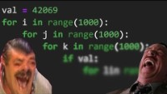
Libraries

Slide 7
Libraries
These allow you to use other people’s code
import time
time.sleep(10) #😴
import pulls in code from a library, like time
. accesses functions from a library, like .sleep(10)
There are a ton of cool libraries to try!

Slide 8
quick note on functions
A function is a named command that completes a specific task
print("Hi")
📞Call a function with parentheses ()
This will cause the function to run 🏃‍♂️
print is a function
input is a function
time.sleep is a function

Slide 9
quick note on comments
Comments are lines of code starting with # that Python totally ignores
print("Hi")
# print("Bye")
print("Hey")
# print("Ney")
Output?
Hi
Hey

Slide 10
Questions?
Hyland Python Academy @ UCS
Notes:
Anyone have any questions?

